Slide 1
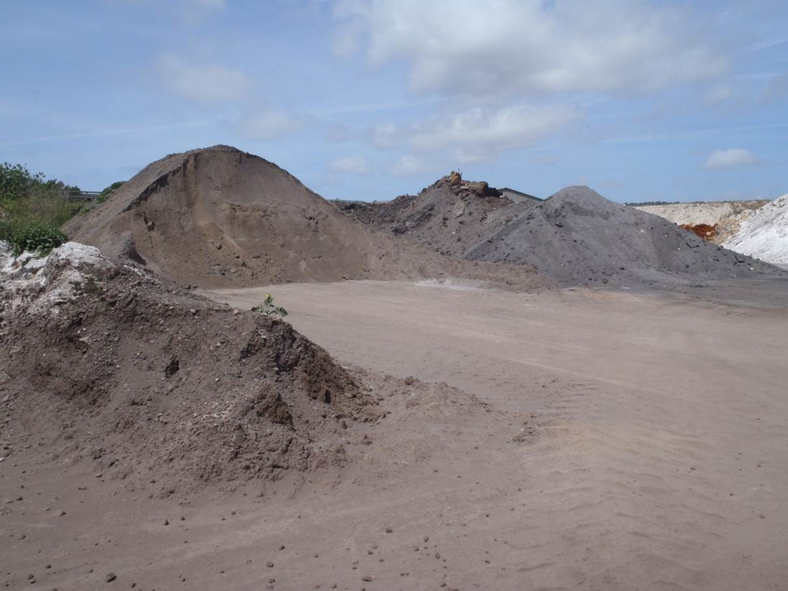
How to maximize Alternative Raw Materials
PPE Course

Slide 2
Training objective
Know the difference between traditional and alternative raw materials
Understand the potential benefits of AR usage
Be able to explain the critical aspects of AR usage regarding operation, process and quality
Be able to propose proper feed locations for specific ARs

Slide 3
Agenda
Definition and Classification of AR by PCS
Use in Legacy Holcim
Recognizing the Potential of Application
Recognizing Critical Aspects
Appropriate Handling and Control
Conclusions and Message

Slide 4
Definition and Classification of AR
Notes:
Pre-readings:
AFR, AR and AF
What do this abbreviations stand for?
AFR = Alternative Fuels and Raw Materials
AF = Alternative Fuels
AR(M) = Alternative Raw Materials

Slide 5
Definition of Alternative Raw Materials and Fuels
Traditional raw materials are the materials gained from quarries or purchased from primary material supplying industries
All fuels and raw materials, which are not traditional, are alternative
→ (HARP Accounting and Reporting Manual Para. 8.3.9.1 AFR Classification)
Practical interpretation for AR: Alternative raw materials are raw materials that have undergone any kind of previous industrial processing
Notes:
Check if definitions and classifications stay the same in legacy Lafargeholcim

Slide 6
Distinction between AF and AR (HARP)
Alternative raw materials:
Wastes with a mineral mass fraction (i.e. ash content) contributing to clinker production higher than 50%
(CaO + SiO₂ + Al₂O₃ + Fe₂O₃ + SO₃ > 80% of ash mass)
Alternative fuels:
All other wastes not classified as AR

Slide 7
Raw material classification according to PCS
PCS values |  | Examples
Traditional | Calcareous components | Limestone, chalk, marl
 | Siliceous/argillaceous comp. | Clay, shale, sand, silica fumes
 | Alumina-rich components | Bauxite, kaolin
 | Iron-rich components | Iron Ore, Magnetite
 | SO₃ provider | Gypsum, anhydrite
 | F provider | Fluorspar

Slide 8
Raw material classification according to PCS
PCS values |  | Examples
Alternative | Calcareous correctives | Lime sludge, Ca(OH)2
 | Siliceous correctives | Foundry sand, silica gel
 | Aluminous correctives | Aluminum hydroxide, sludge
 | Ferrous correctives | Mill scale, pyrite ash, sludge
 | Sulfur provider | Desulfuration products
 | Fluor provider | Spent pot liners
 | Contaminated soils | Contaminated soil, drill cutting
 | Other raw mix correctives
 | Other alternative raw materials

Slide 9
Raw material classification according to PCS
PCS values |  | Examples
Ashes | Fly ash | Fly ash, paper ash
 | Bottom ash | Bottom ash, fluidized beds
Slags | Non granulated blast furnace slag | non GBFS
 | Granulated blast furnace slag | GBFS
 | Other slags | Steel slag, foundry slag

Slide 10
Use in Legacy Holcim
Notes:
Pre-readings:
AFR, AF AR
Where do we use these materials?
Substitutes for traditional fuels
Substitutes for raw materials used for raw mix; mainly used for correction of raw meal composition

Slide 11
AR consumption in legacy Holcim
Evaluation of plant data 2015 (excl. China)
185 (131) Mio t of raw materials prepared (for clinker production)
4.4 (3.6) Mio. t (wet) total consumption of AR
AR make up about 2.4 (2.7) % of total raw material consumption (wet) for clinker production
68 (75) out of 100 Plants (68 resp. 75 %) use alternative raw materials in their raw mix

Slide 12
Types of AR used (PCS 2015)

Slide 13
Consumption of AR in different regions (2015)

Slide 14
Optimization of use
Recognize potential
Recognize critical aspect
Appropriate handling and control
Motivation
Challenge
Success

Slide 15
Recognizing the Potential of Application

Slide 16
Potential benefits of AR utilization
Reducing raw material costs
Improving operation costs
Improving clinker/cement quality
Strategic objectives
Saving of natural resources
Control and management of specific material resources
Providing a service for the society

Slide 17
Potential for AR substitution as a function of raw materials
AR substitution rate
Limestone, marl, clay |  | Fly ash, slag, bottom ash, drill hole cutting
Marly limestones, correctives |  | Corrective AR
“Cement stone” |  | AR with low impact on composition
Raw materials situation |  | Potential AR
high
low

Slide 18
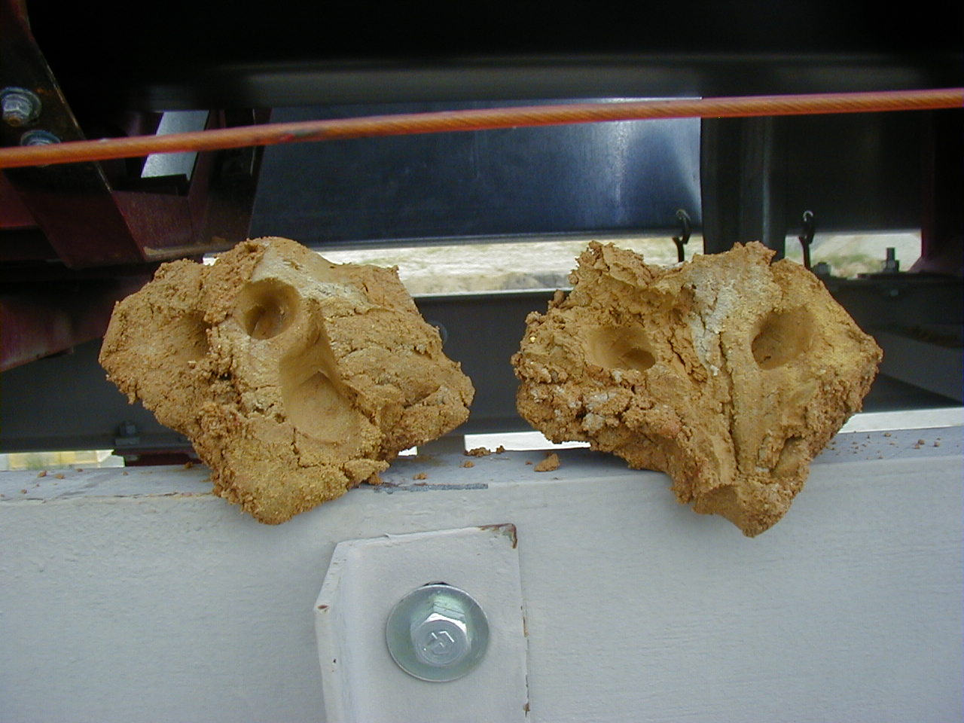
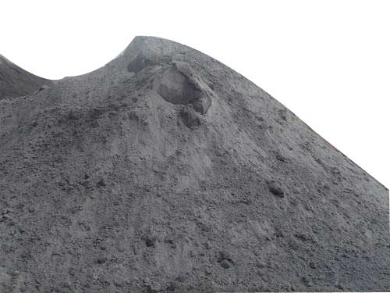
AR replacing a main component: Improved operations (Example Theodore)
Situation
Sticky clay, difficult to handle, requires drying
Costly operation, high raw meal variations
Objective
Eliminate costs in handling and drying of clay
Reduce raw mix variability
Solution
Complete replacement of clay with fly ash
Small corrections with additional AR’s
Upgrade of fly ash feed systems
Aspects
Quarry reserves, mining plan
Clay
Replaced by
Fly ash
18

Slide 19
Replacement of clay by fly ash: Example Theodore (cont.)
Theodore Raw Mix (%) |  | 1998 | 2003 | 2010
Traditional | Crystal River Limestone | 80.54 | 77.88 | 81.18
 | Vulcan Limestone | 1.19 | 6.21 | 4.77
 | Axis Clay | 11.02 | --- | ---
 | Sand | --- | 3.68 | 1.34
 | Iron Ore | 0.91 | 0.93 | 0.51
Alternative | Fly Ash | 6.34 | 10.11 | 10.93
 | Bottom Ash | --- | 0.05 | ---
 | Mill Scale | --- | 0.15 | 0.70
 | Black Beauty (other corr.) | --- | 0.44 | ---
 | Filter Press Cake | --- | 0.20 | ---
 | Lime AFR (calcium corr.) | --- | 0.22 | ---
 | Spent Catalyst (alumina corr.) | --- | 0.07 | 0.57
 | Paper Sludge (other corr.) | --- | 0.06 | ---

Slide 20
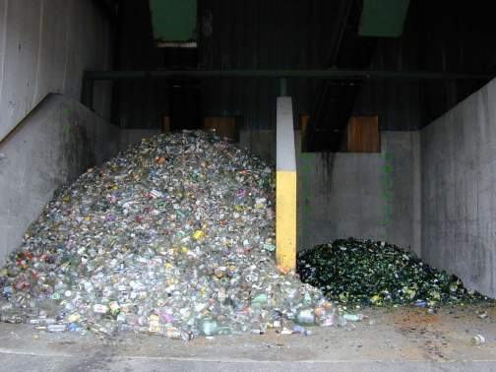
AR as quality enhancer: Example Thayngen
Situation
Unsatisfactory cement setting behavior and strength development
Objectives
Increase soluble alkali sulfate content in clinker
Solution:
Use of waste glass (11 % Na₂O) instead of sand
Use of gypsum in the raw mix

Slide 21
AR as quality enhancer: Example Thayngen (cont.)
Thayngen raw mix (%) |  | before | after
Traditional | Limestone | 54.45 | 57.86
 | Marl | 34.40 | 32.08
 | Sand | 6.78 | 0.31
 | Others | 0.16 | 0.93
Alternative | Pyrite ash | 1.06 | 0.92
 | Iron sludge | 0.16 | 0.16
 | Foundry sand | 2.34 | 4.62
 | Waste glass | -- | 2.10
SO₃ in clinker |  | 0.44 | 0.75
Na₂O in clinker |  | 0.40 | 0.74

Slide 22
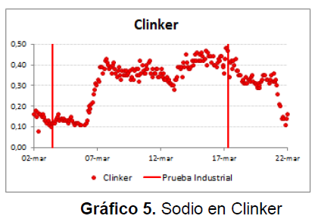
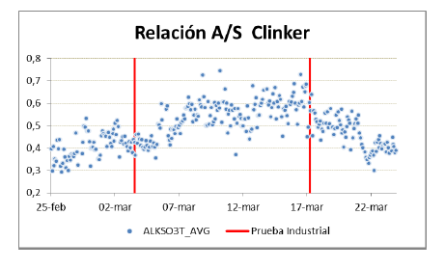
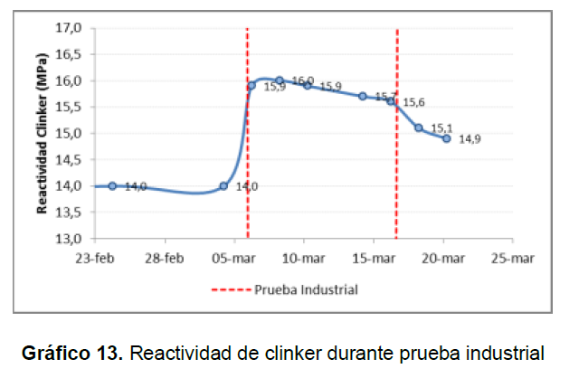
Recent experience with waste glass: Example Cartago
Waste glass was mixed with pozzolana as silica corrective (1:2 ratio) and introduced to the raw mix.

Slide 23
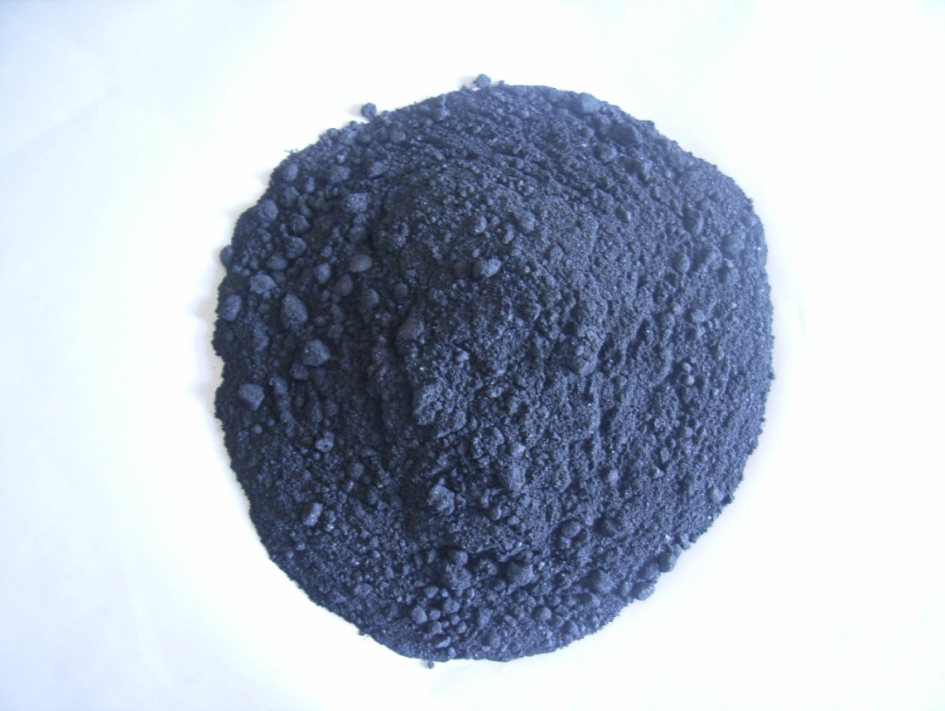
Example Treated SPL (spent pot liners)
Benefits: Increased alkali input, substitution of fluorspar, increase of TSR
Lower raw mix costs, lower fuel costs, more reactive clinker if excessive SO₃
Treated SPL analysis
C | 40 to 45 | %
Net Cal. Val. | >12 | MJ/kg
Al₂O₃ | 17 to 22 | %
Na₂O | 14 to 19 | %
F | 10 to 15 | %
SiO₂ | 6 to 12 | %
Fe₂O₃ | 2 to 7 | %
CaO | 1 to 3 | %
K₂O | 0.1 to 0.5 | %
SO₃ | 0.1 to 3 | %

Slide 24
Treated SPL use: Example for a 1 Mio tpa clinker line
Treated SPL feeding to the coal mill (Covered storage needed). Delivered in vessels of 5’000t, 30 USD/t at plant gate.
Maximum potential: 18’000 t/y (corresponding to 6% TSR) due to F content in clinker; replacing Petcoke

Slide 25
List of typical AR candidates
Material class | Examples | Source | Potential issues | Benefits
Fe correctives | Low grade iron-ore, mill scale | Iron mining, steel industry | Trace elements (e.g. Cr) | Reduced material costs
Si correctives | Foundry sand, rice husk ash | Metal foundry, rice husk incineration | High content of organics/ TOC/ generation of VOC | Reduced material costs
Al correctives | Spent catalysts, (Bauxite) | Chemical industries, oil refinery, Al industry | High content of organics / VOC emission | Better raw mix control; (reduced material costs)
SO₃ provider | Phosphogypsum, Fluorogypsum, artificial gypsum from flue gas cleaning | Fertilizer industry, incineration, Chemical industries (HF production) | High moisture, handling issues; High content of P₂O₅ and F | Clinker quality improvement, if sufficient alkalis
Bottom ash / fly ash |  | Incineration processes | Granulometry, handling issues, high TOC content | Reduced material costs
Calcium correctives | Ca sludges | Sugar industry, paper industry | High content of organics / VOC emissions | Reduced material costs

Slide 26
Recognizing Critical Aspects
Notes:
Pre-readings:
AFR, AF, AR
How can they influence our process?
Instable process, increased build-ups, volatilization, flame shape (burning & cooling conditions)
Increased burnability (lower STEC)

Slide 27
Overview of impact of critical properties
Properties | Environment | Health & Safety | Plant Operation | Product Quality
Physical properties (granulometry, moisture, heterogeneity) |  |  | X
Major elements (CaO, SiO₂, Fe₂O₃, Al₂O₃, etc…) |  |  | X
Minor elements (Cl, F, SO₃, alk, MgO, etc..) |  |  | X | X
Trace and heavy metals (Cr) | X | X |  | (X)
Organics (TOC, toxic components) | X | X | X
Mineralogy (quartz, mullite etc.) |  |  | X | X

Slide 28
Physical Properties
Property | Relevant to
Moisture, stickiness | Storage, feed devices
Granulometry | Storage, feed location, dust
Crushability, Grindability | Preparation process
Heterogeneity | Raw mix variability
Foreign bodies (e.g. metals) | Equipment performance & availability
Odor | Working conditions
Impact on rheology | Slurry preparation

Slide 29
Major elements
Take into account the AR addition on:
Changed proportions in raw materials
Impact on mining (reserves), storage, blending

Slide 30
Minor elements
Element | Relevant to
MgO | Limits in standards
SO₃ | Alkali-sulfur balance
Cl | Build-ups, quality (dust to cement)
F | Strength, setting
P₂O₅ | Strength, setting
History of material has to be known, to recognize other potentially critical minor elements (Sr, Ba, Br, I, etc.)
Balance and assessment is identical as applied for traditional raw materials

Slide 31
Trace and Heavy Metals in Clinkers
When secondary and natural Fe bearing materials are used, trace elements content is often increased, especially Cr
Can increase the water soluble chromate content in the cement significantly (limited to 2 ppm in Europe)
More reducing agent (Fe(II)-sulfate) would have to be added to the cement in order to comply with regulation
No guidelines for heavy metal contents in AR and clinker exists
Refer to internal investigation of Heavy Metal contents in clinkers and cements of the Holcim group (Report CIE-ETPS 02/7071/E)
Recommendation:
Respect official emission limits for heavy metals
Pay special attention to Cr-level, in view of soluble chromate content in cement

Slide 32
Organic Components
Property | Relevant to
TOC | Heat input, feed location
VOC | Emission
Dioxin / Furan | Emission, handling
PCB | Emission, handling
Recommendation:
TOC- and expulsion testing is of high priority, as they are decisive for feed location
Feed AR to hot zone of kiln if increased emissions are expected

Slide 33
Mineralogical Composition
Property | Relevant to
Quartz content / size | Burnability, strength potential, health regulations
Refractory minerals | Assimilation into clinker, burning behavior
Recommendation:
Determine mineral composition of AR and impact on raw meal burnability
Tools: XRD, microscopy and burnability test (physical-chemical burnability model)

Slide 34
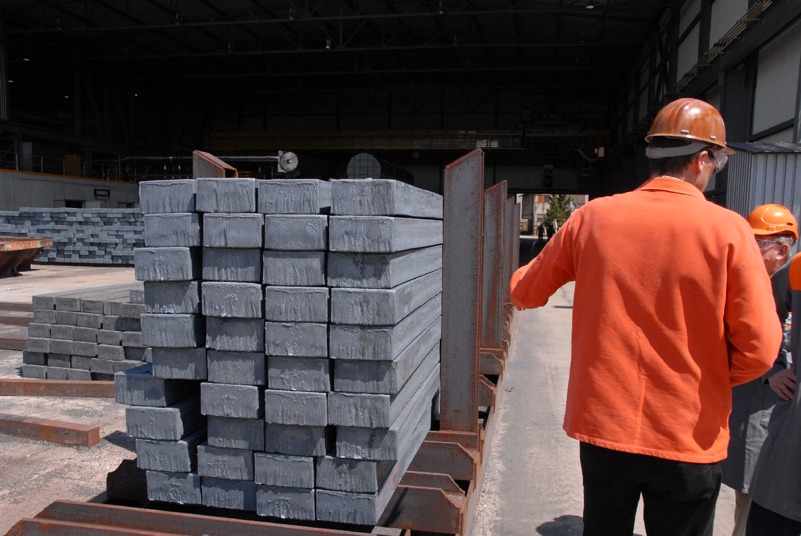
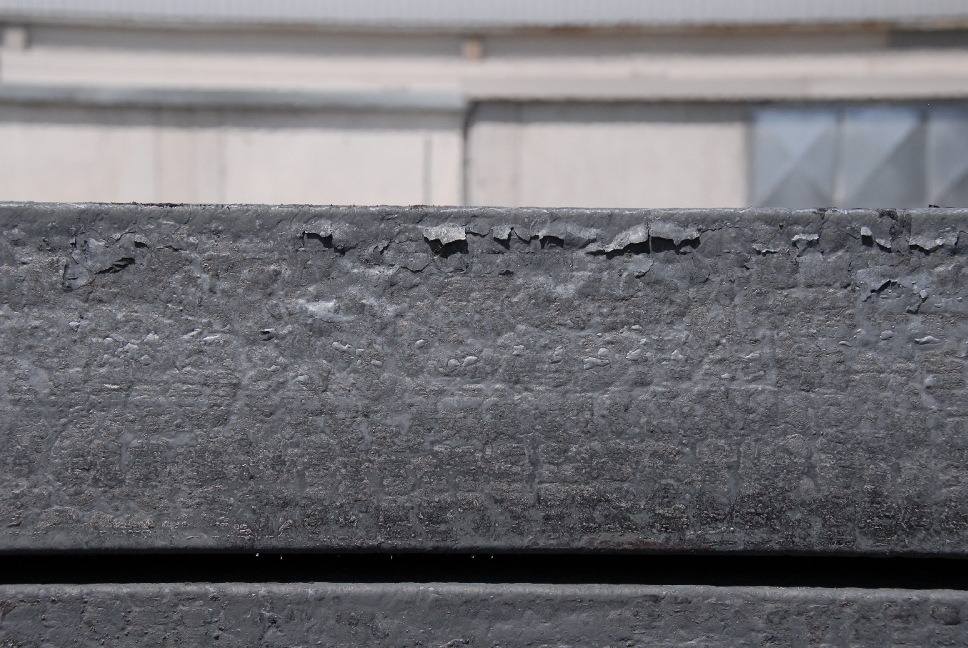
Example: Investigation of mill scale samples

Slide 35
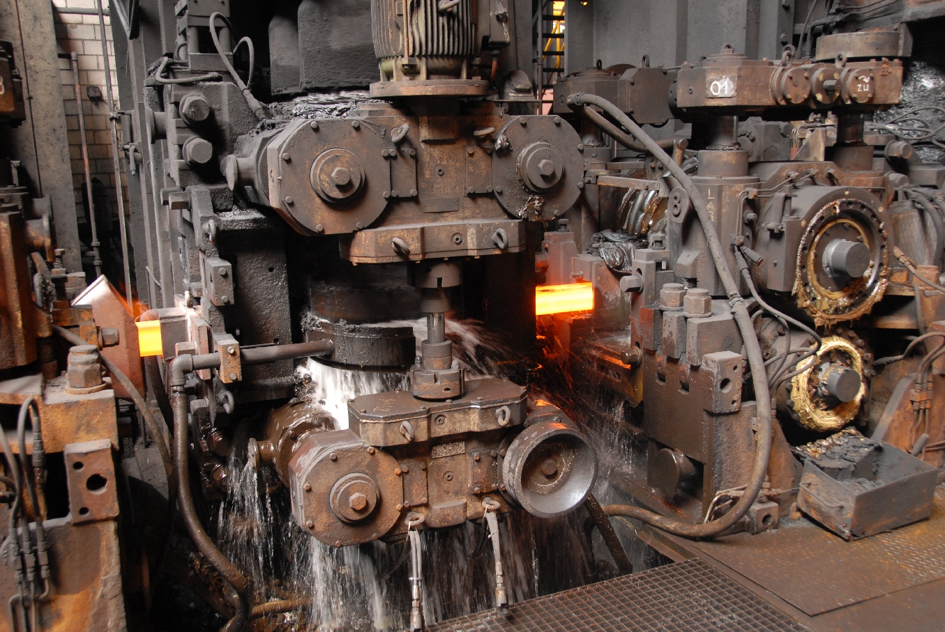
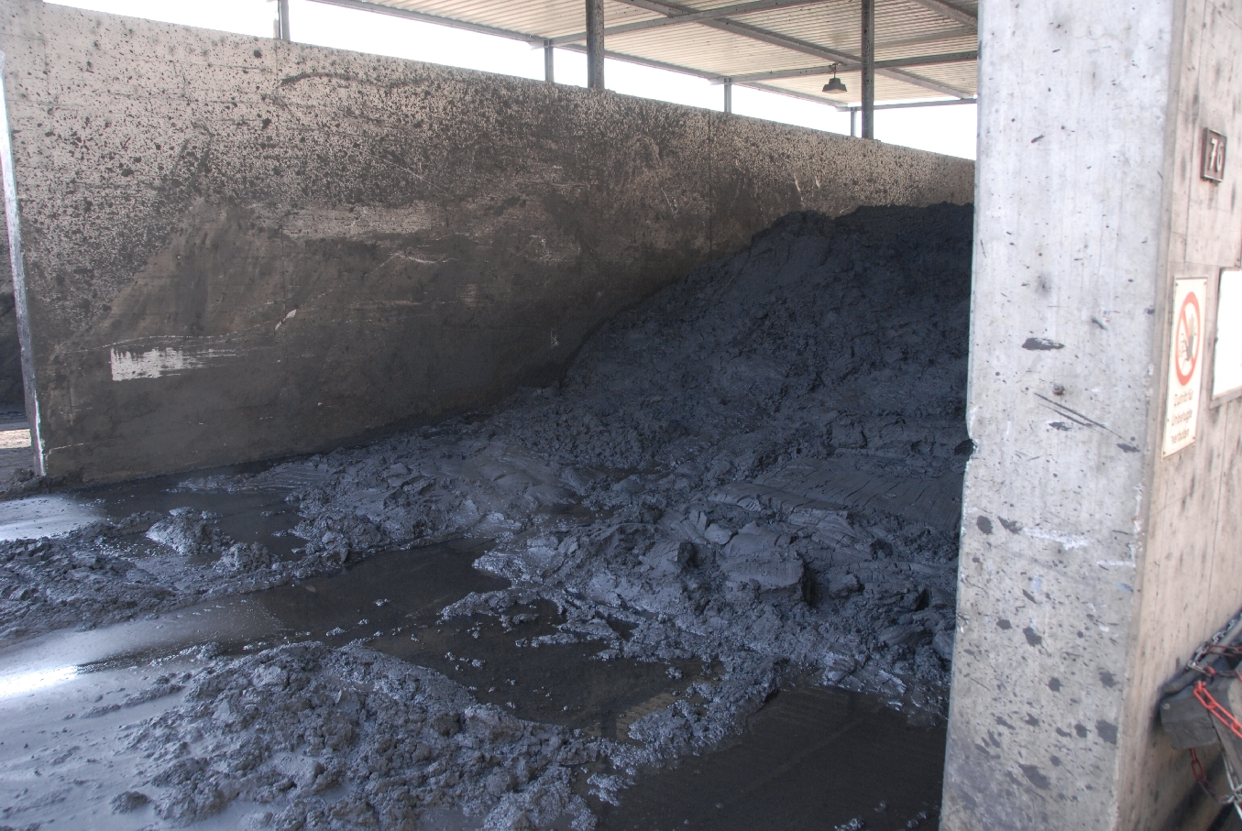
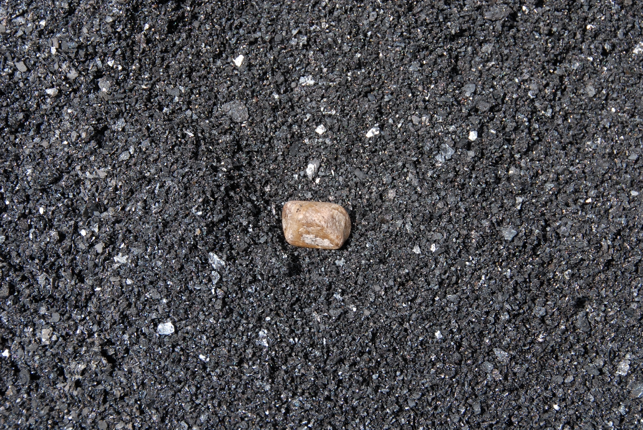
Example: Investigation of mill scale samples
Fine fraction
Coarse fraction

Slide 36
Example: Investigation of mill scale samples (coarse/fine fraction)
Heavy metals
Sulfur and organics
 | Mn | Co | Cr | Cu | Mo | Ni
Mill scale coarse [ppm] | 7900 | 590 | 1300 | 1840 | 270 | 390
Mill scale fine [ppm] | 5300 | 590 | 1090 | 3120 | 400 | 940
Fine: Additional input at 1% in raw mix [ppm cli] | 82 | 9 | 16 | 50 | 6 | 15
Parameter | Mill scale coarse | Mill scale fine
SO₃ (Leco SC) [%] | 0.05 | 0.11
TC [%C] | 0.17 | 2.09

Slide 37
Example: Investigation of mill scale samples (coarse/fine fraction)
Expulsion test
Additional VOC for each 1 % in raw mix
Expelled mass |  | Mill scale coarse | Mill scale fine
 |  | dried at 45 °C | wet
Identified VOC species | [mgC/kg] | 42 | 610
Total VOC | [mgC/kg] | 128 | 1600
Compound |  |  | Mill scale coarse | Mill scale fine
VOC |  | [mgC/Nm³] | 0.69 ± 0.14 | 8.7 ± 1.5
Benzene | C₆H₆ | [mgC/Nm³] | 0.023 ± 0.007 | 0.13 ± 0.03

Slide 38
Appropriate Handling and Control

Slide 39
Appropriate handling and control
Enable maximum, sustainable utilization of selected AR by:
Appropriate storage and dosage, to ensure controlled and regular feed to the process
Adequate quality control concept, including AR control upon delivery
Good control and high uniformity of traditional raw mix, kiln feed and clinker is a precondition for maximizing AR and AF

Slide 40
Solutions for feed locations and control
Selection of appropriate feed point
Design of appropriate storage and feed systems
Location | Criteria | Examples
Crusher / preblending | Very coarse material | Cont. soils, refractories
Raw mill feed | Coarse material | Foundry sand, mill scale, etc.
Raw mill separator | Fine, dry | Fly ash
Kiln inlet (long) | Fine/granular | Blast furnace slag (BFS)
Mid-kiln (long) | Fine/granular, organics | BFS, high-C fly ash
Kiln inlet / precalciner | Fine/granular, organics | BFS, high-C fly ash

Slide 41
Conclusions and Message

Slide 42
Conclusions
Prices of alternative materials can, but need not, be favorable in comparison to traditional raw materials
Benefits from AR can arise from reducing operational costs, improving quality, saving reserves, and strategic reasons
Maximum utilization requires careful assessment and hence correct selection of AR to be accepted, together with appropriate installations to ensure regular feed
A systematic approach to sourcing, evaluation and utilization will bring the overall economic benefit of AR utilization

Slide 43
Message
The full potential of AR utilization awaits to be exploited
Identify opportunities at your plant
Examine carefully and comprehensively possible critical characteristics
Provide adequate installations for storage and feed
Implement adequate quality control to ensure sustainable, safe and profitable utilization

Slide 44
Annex

Slide 45
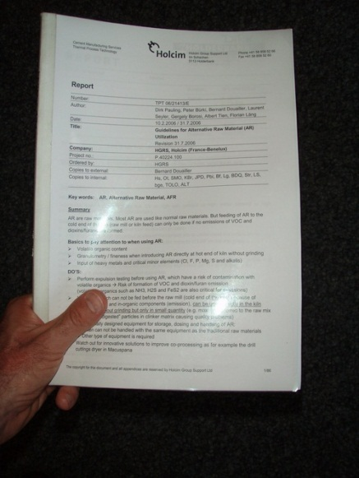
Objective and contents of “Guidelines for Alternative Raw Material (AR) Utilization”
Objective of “AR Guidelines”:
Compilation of know-how which gives guidelines how to use AR successfully (no negative impact on environment, quality, production and H&S)
Contents of “AR Guidelines”:
Feed point selection
Criteria and tests for AR
Impact of AR on quality, kiln operation and emission
Storage and handling of AR
H&S aspects of using AR
Special solutions for using coarse AR containing volatile organics

Slide 46
AR with high economic benefit
Often, such materials exhibit difficult characteristics in terms of physical properties, heterogeneity and environmentally relevant components.
Typically used in relatively low quantities and with small impact on clinker properties.
Example: Vanadium ash (cost: ~ -200 USD/t: )
Comprehensive assessment is particularly important!

Slide 47
Heavy Metal Contents in Clinker
Metal | Average | Min. | Max.
 | [mg/kg] | [mg/kg] | [mg/kg]
Cd | 0.58 | < 0.50 | 9.0
Hg | < 0.002 | < 0.002 | 0.009
Tl | < 0.40 | < 0.40 | < 0.40
As | 13 | 1.8 | 90
Co | 18 | 6.0 | 42
Ni | 36 | 10 | 242
Cr | 83 | 19 | 614
Cu | 127 | 8.1 | 367
Pb | 15 | < 1.5 | 133
Sb |  | < 0.15 | 1.0
Sn | 11 | < 0.70 | 26
V | 92 | 24 | 481
Be | 0.95 | 0.28 | 3.8
Zn | 116 | 13 | 675
Avg. Cli AF | Avg. Cli foss.
[mg/kg] | [mg/kg]
0.65 | 0.52
< 0.002 | < 0.002
< 0.40 | < 0.40
12 | 15
18 | 18
33 | 40
77 | 89
132 | 120
15 | 16
< 0.5 | < 0.5
13 | 10
95 | 88
1.05 | 0.83
158 | 67

Slide 48
Solutions for feed locations and control: Example Höver
Situation
Increasing grade of limestone in the quarry requiring additional external components
Feed of corrective materials at quarry caused deterioration of kiln feed uniformity
Objective
Reduce kiln feed variability and reduce LS level, to improve refractory life and heat consumption
Have dosage facility available for possible future materials
Solution
Well-designed, flexible installation for storage and dosage of 4 components ahead of the raw mill

Slide 49
Plant example: Höver
Year | Kiln feed std LS | Correctives / AR added at quarry
1993 | 1.10
1994 | 1.00
1995 | 1.52 | Natural sand
1996 | 1.46 | as above
1997 | 2.27 | Oxiton, iron ore, natural sand, blast furnace slag
1998 | 2.12 | as above
1999 | 3.32 | as above

Slide 50
Solutions to facilitate operation: Höver (cont.)
Weigh-bins
Storage bays
Storage bays
not used anymore
50m³
Quarry
Raw Material Hall
Blending Silo
50m³
10.000 t
Marl „target“
Marl „high“
Kiln

Slide 51
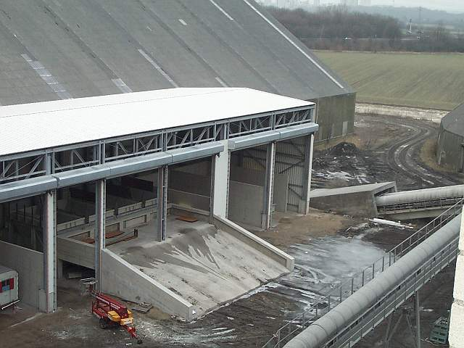
Solutions for feed locations and control: Höver (cont.)

